Slide 1
A Short Introduction to EndNote Master students in Neuroscience
Jan Ove Rein Library Section for Teaching and Learning Support, NTNU University Library August 2024

Slide 2
An introduction to EndNote
You can download this presentation from:
https://folk.ntnu.no/janove/PDF

Slide 3
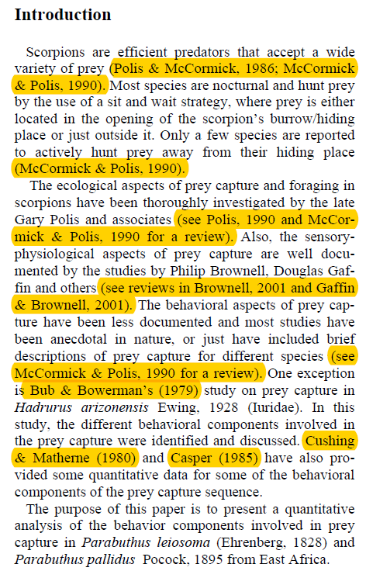
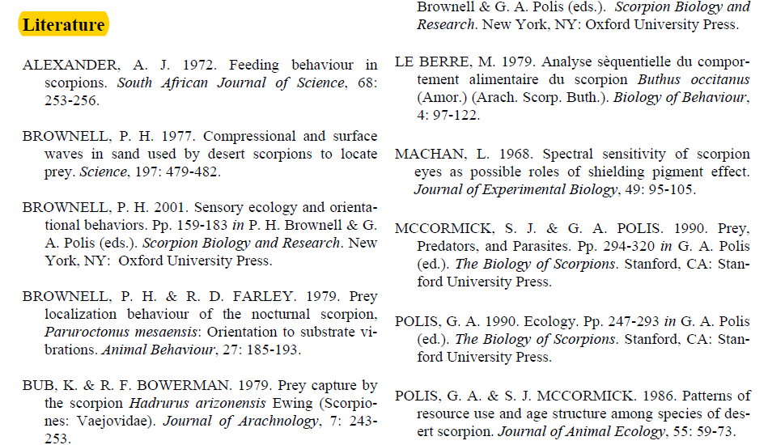
An introduction to EndNote
You can use EndNote to:
Create a library with the literature (references) that you use in your Master thesis, or that you are going to use in future manuscripts.
Find the full text of your literature and save this in your library.
Insert references from the library into your text as in text citations and get a formatted bibliography in the end of the text in the style you need. You have 6000+ styles available.
Change the formatting (style) of the citations and bibliography quickly when needed.
Create a library for co-operation using EndNote Library Sharing for your co-authors or research group.

Slide 4
An introduction to EndNote
How to get EndNote:
EndNote is freely available for students and staff at NTNU.
You can download the program from AppsAnywhere
https://i.ntnu.no/wiki/-/wiki/English/AppsAnywhere
More information: https://ntnu-no.libguides.com/EndNote/Installere (Norwegian) https://ntnu-no.libguides.com/EndNote-guide/Installing-EndNote (English) You can contact the Oracle Service if you need help.
Latest main version is EndNote 21 (Windows and Mac).
EndNote 21 can be used together with Word, Apple Pages and Google Docs.
You can create a back up of your library in the following way: File → Compressed library → Next → Save

Slide 5
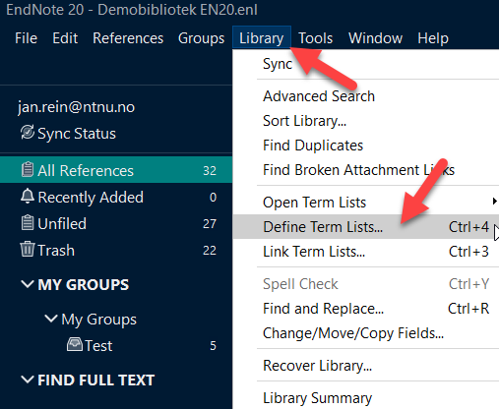
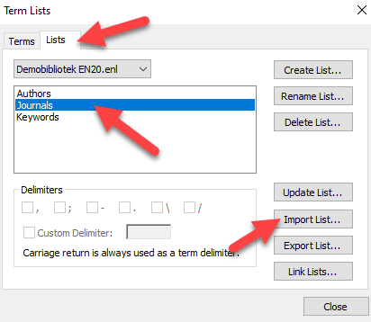
An introduction to EndNote
Creating a new library:
File → New → Save the library on your hard disk or server.
Do not save and run your library from a memory stick or cloud service like Drive, Dropbox or iCloud (it is ok to save a backup copy in cloud services, but do not open and run it here).
Before you start filling your library with content:
Insert NTNU URL in Find full text preferences (See manual for details).
Activate medical term list (standard journal names and abbreviations) for your library:

Slide 6
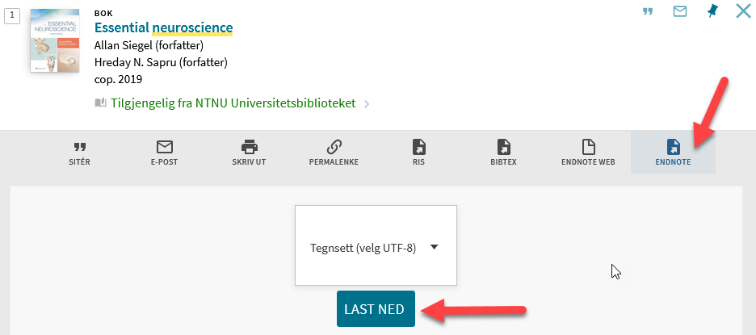
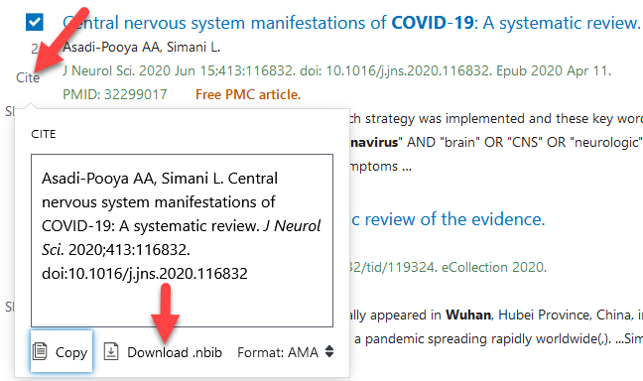
An introduction to EndNote
Filling your library with content – Import references from databases:
Try to find most of the references you need in databases as it is possible to import references directly to EndNote from all the major databases. You can find guides for the different databases here:
https://ntnu-no.libguides.com/EndNote/Legg-til-innhold (Norwegian) https://ntnu-no.libguides.com/EndNote-guide/Add-references (English)

Slide 7
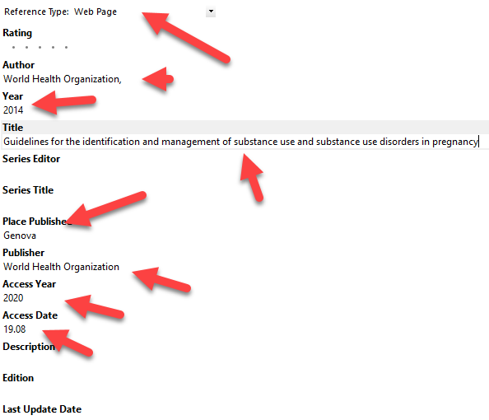
An introduction to EndNote
Filling your library with content – Manually entering references:
Sometimes you need to manually enter references (e.g., book chapters, reports, web pages etc.). It is important to enter the necessary data correctly. See manual/guide for more information.
More style related examples can be found in NTNU Academic Writing:
https://i.ntnu.no/web/guest/academic-writing/using-and-citing-sources

Slide 8
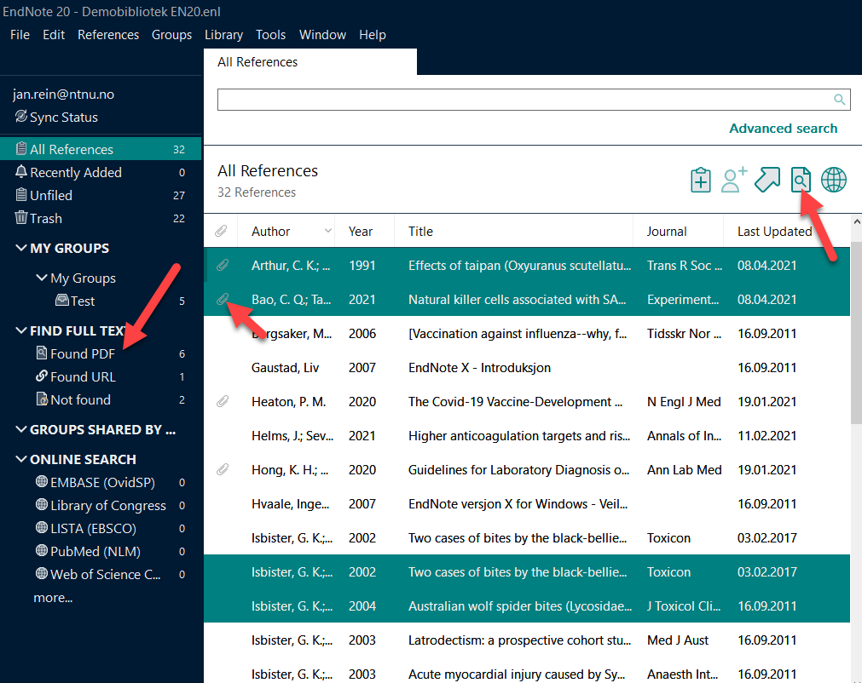
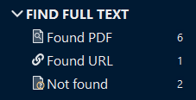
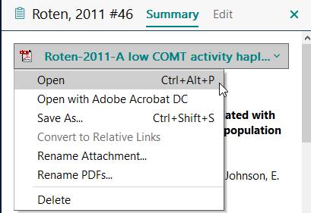
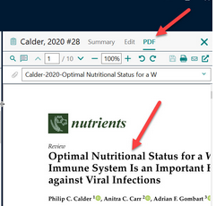
An introduction to EndNote
Find full text:
EndNote can find the full text of a reference for you (mainly articles). You need to be on the NTNU-network for this to work optimally as most journals are subscription journals (use VPN off campus).
https://ntnu-no.libguides.com/EndNote/Legg-til-pdf-til-en-referanse (Norwegian) https://ntnu-no.libguides.com/EndNote-guide/Find-full-text (English)

Slide 9
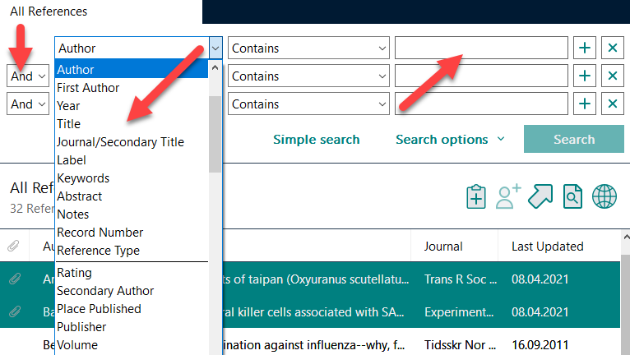
An introduction to EndNote
Search within your library:
You can search for information/references in your library by using the simple search or the advanced search. It is also possible to search for search terms within the pdf files in your library.
https://ntnu-no.libguides.com/EndNote/Legg-til-pdf-til-en-referanse (Norwegian) https://ntnu-no.libguides.com/EndNote-guide/Find-full-text (English)

Slide 10
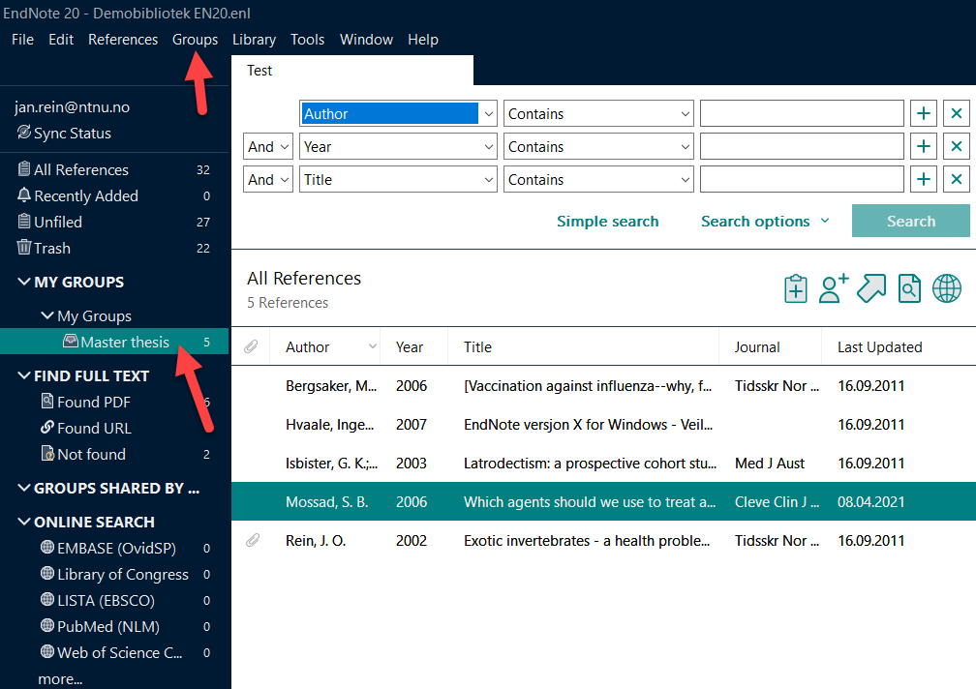
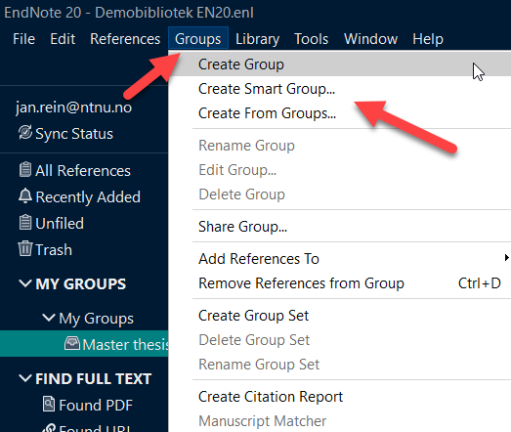
An introduction to EndNote
Library groups:
If you have a large library, it is possible to create permanent groups within the library (e.g., a project group (an article you are writing) or a topic group (we usually have several topics of interest within our discipline)). You can make manual groups or smart groups based on a search strategy. See manual for more information.
https://ntnu-no.libguides.com/EndNote/Grupper-tagger (Norwegian) https://ntnu-no.libguides.com/EndNote-guide/Use-groups-and-tags (English)

Slide 11
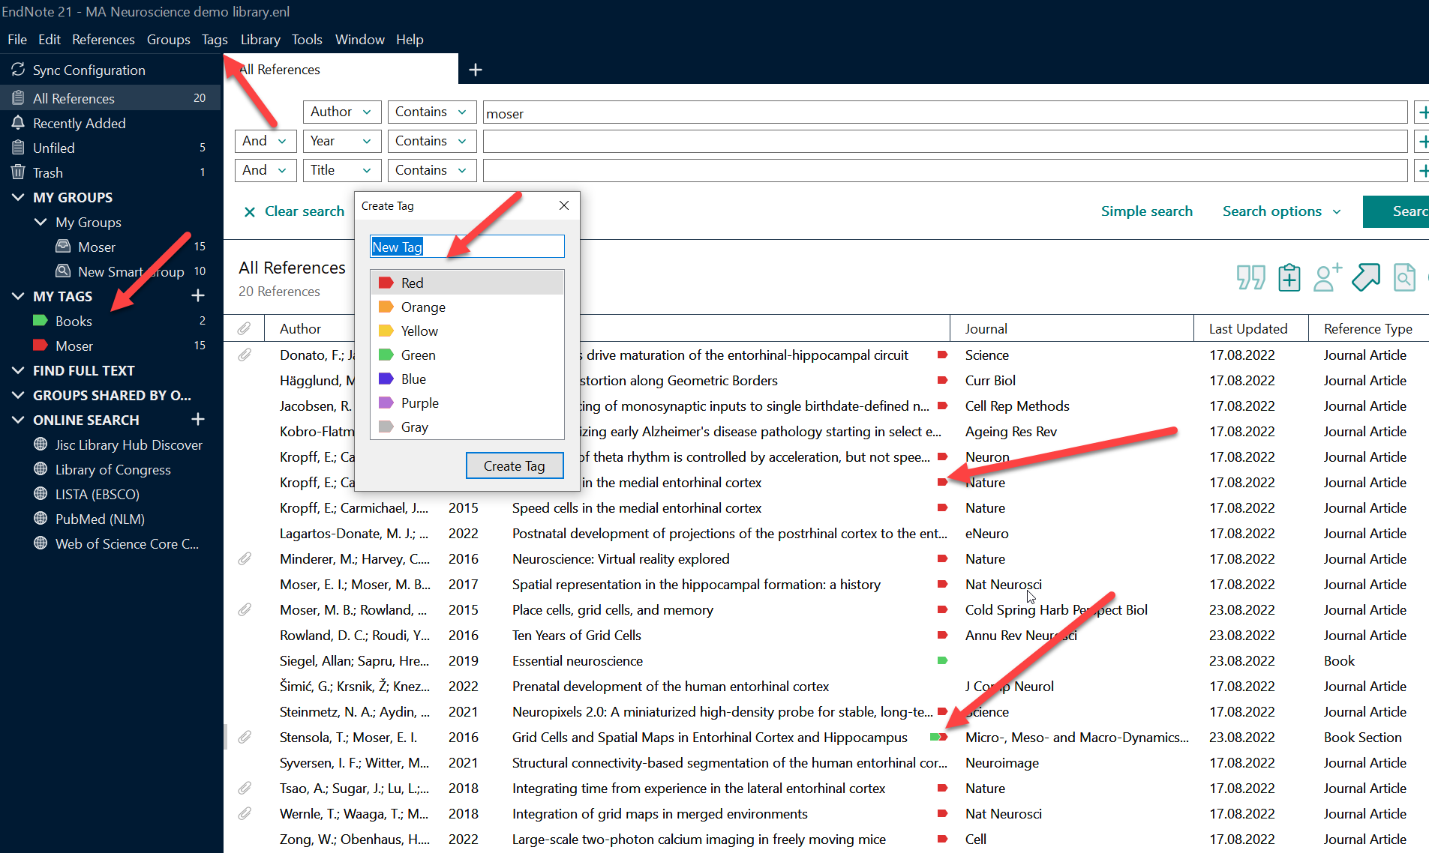
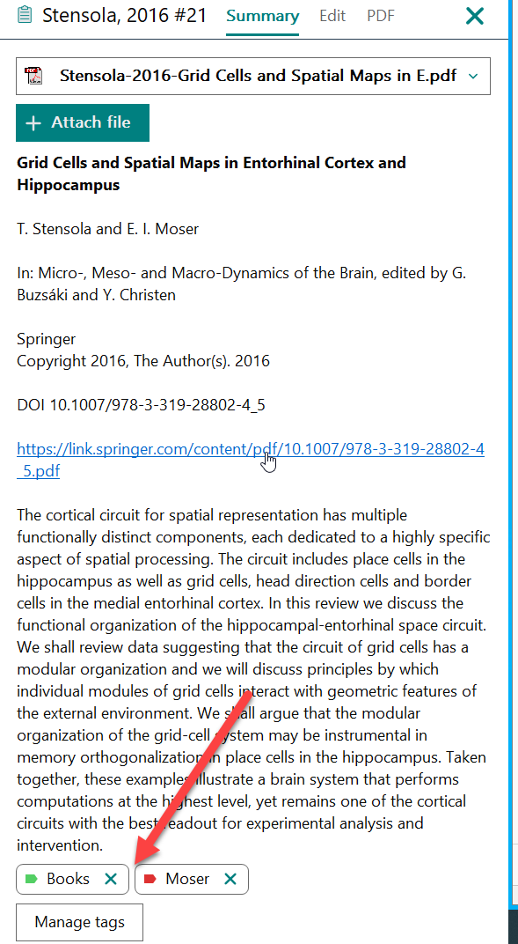
An introduction to EndNote
Tags:
A new function in EndNote 21 is the possibility to create visual tags with names and colors. The tags are shown in the list of references, and you can get a list of all references tagged with one color from the My Tags menu in the left pane. Tags work in the same way as groups.
https://ntnu-no.libguides.com/EndNote/Grupper-tagger (Norwegian) https://ntnu-no.libguides.com/EndNote-guide/Use-groups-and-tags (English)

Slide 12
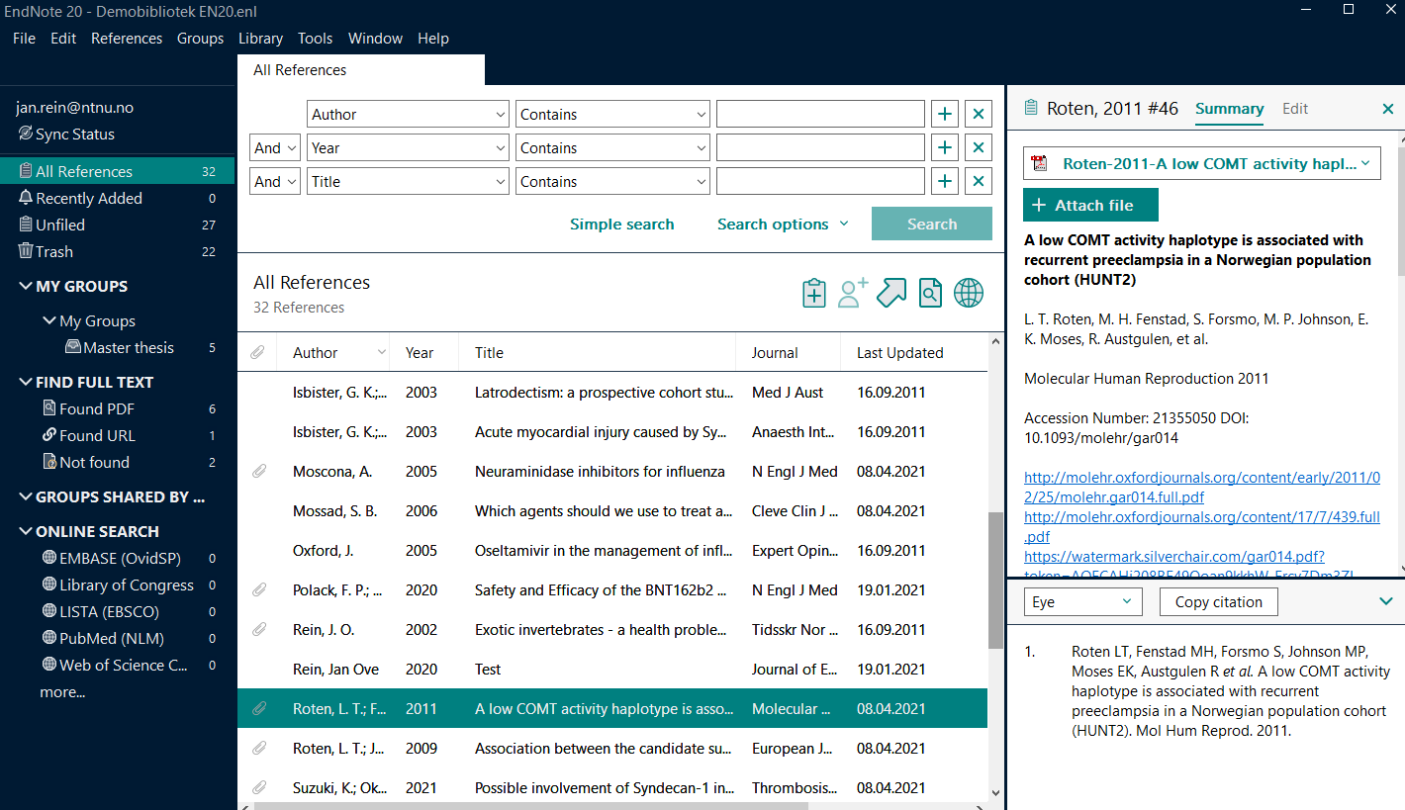
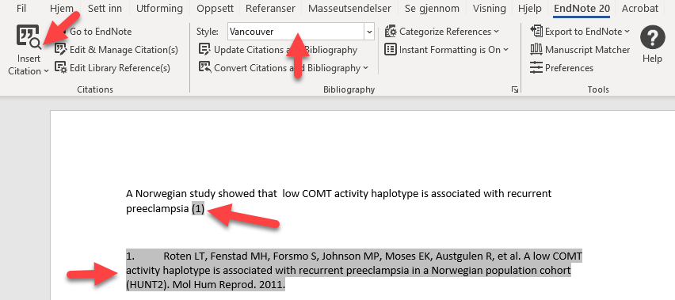
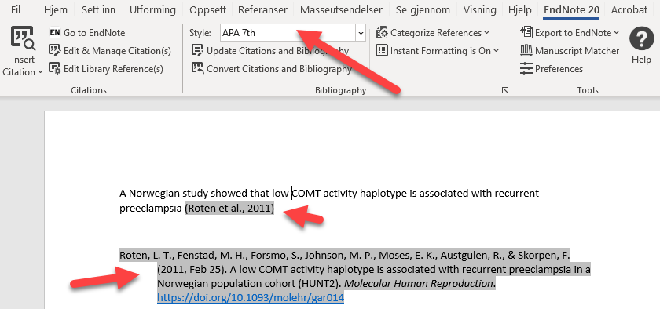
An introduction to EndNote
Using EndNote with Word to create citations and a reference list in the required style:
EndNote can assist you in creating citations and reference list in your manuscript in the required style. See demonstration and the manual for more information.
https://ntnu-no.libguides.com/EndNote/Manusskriving (Norwegian) https://ntnu-no.libguides.com/EndNote-guide/Inserting-and-formatting-references-in-Word (English)

Slide 13
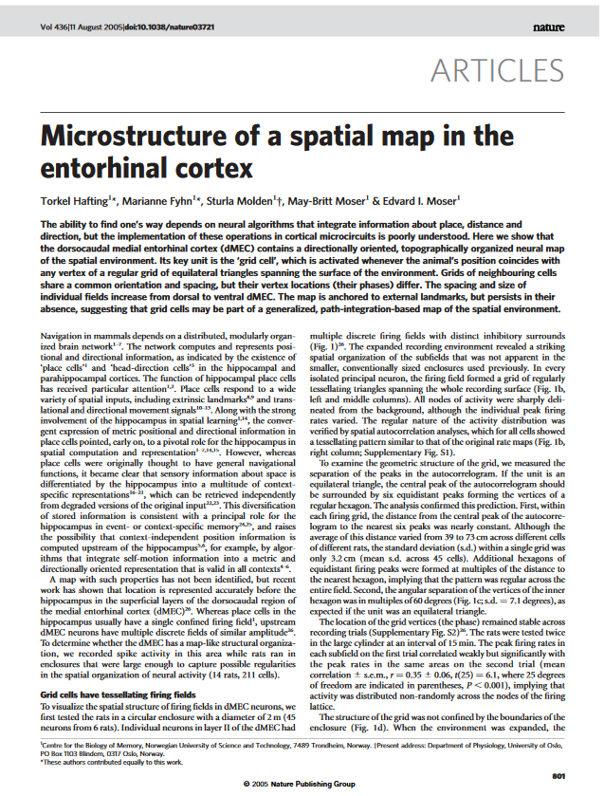
EndNote and cooperation – Library Sharing
EndNote Online
How to use Library Sharing:
https://ntnu-no.libguides.com/EndNote-guide/Cooperation-and-library-sharing (English) https://ntnu-no.libguides.com/EndNote/Deling-bibliotek-samarbeid (Norsk)

Slide 14
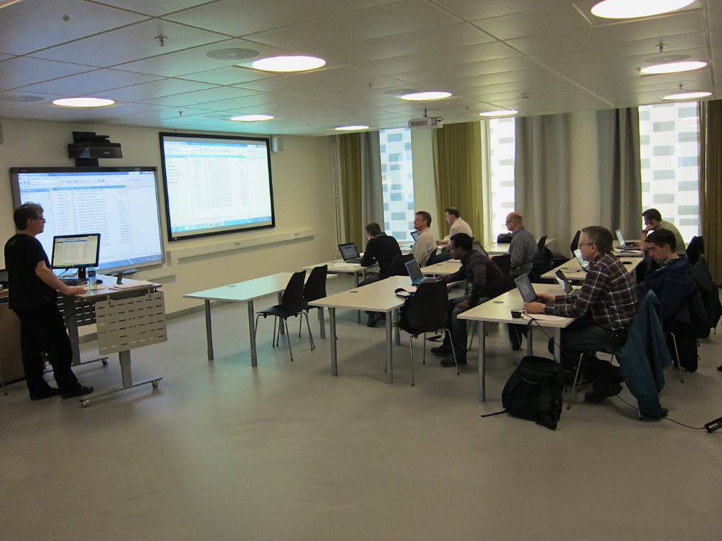
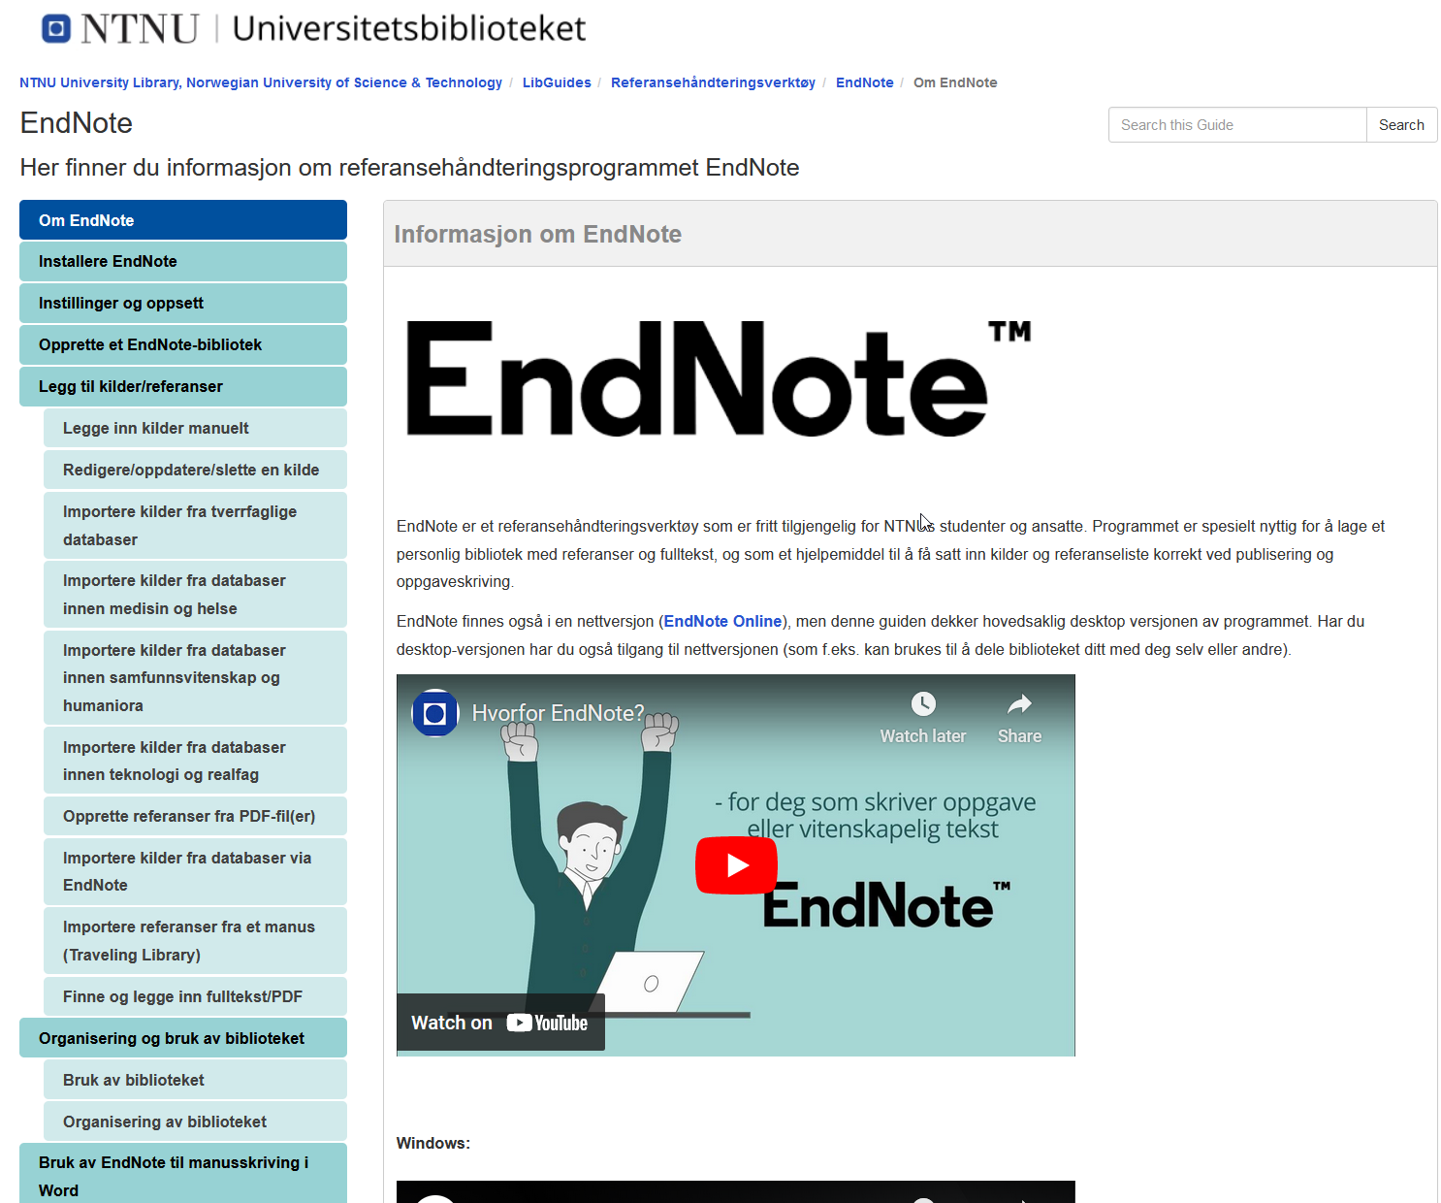
An introduction to EndNote
Do you need an EndNote course?
Local open courses for medicine and health sciences (Physical courses, but digital participation is possible):
https://www.ntnu.no/ub/fagside-medisin-og-helse-kurs-og-veiledning (Norwegian)
Open, digital courses in EndNote available for students and staff at NTNU:
https://kurspaamelding.no/ntnu-ub/referansehandtering (English or Norwegian)
Check out our EndNote support pages:
https://ntnu-no.libguides.com/EndNote/EndNote (Norwegian)
https://ntnu-no.libguides.com/EndNote-guide/ (English)
Course guide from The Medicine and Health Library:
https://www.ntnu.no/blogger/ub-mh/wp-content/uploads/sites/21/2023/08/Introduksjon_EndNote_21.pdf (Norwegian)
https://www.ntnu.no/blogger/ub-mh/wp-content/uploads/sites/21/2023/08/Introduction_EndNote_21_eng.pdf (English)

Slide 15
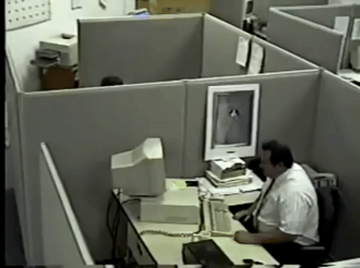
An introduction to EndNote Do you need help?
Contact The Library:
bmh@ub.ntnu.no 73 59 53 00

