Slide 1
Information from the library:
EndNote Library Sharing – Share EndNote library and and write mauscript together
Citation tracking using interdisiplinary citation databases
Medicine and Health Library Mars 2016

Slide 2
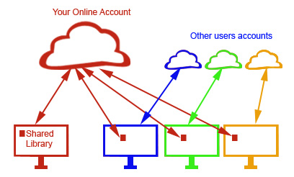
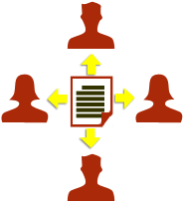
EndNote Library Sharing
Up to 14 users can share the same library and can write a manuscript together using this library without any problems.
All users need version X7.2 or higher and need to have an account on EndNote Online.
The one creating a shared library cannot sync other libraries (only possible sync one library), but users using one or more shared library can sync their own library.
It may be wise to create a special library for a research group and not use your own personal library for this purpose.
Figures from Crandon Services (www.crandon.com)

Slide 3
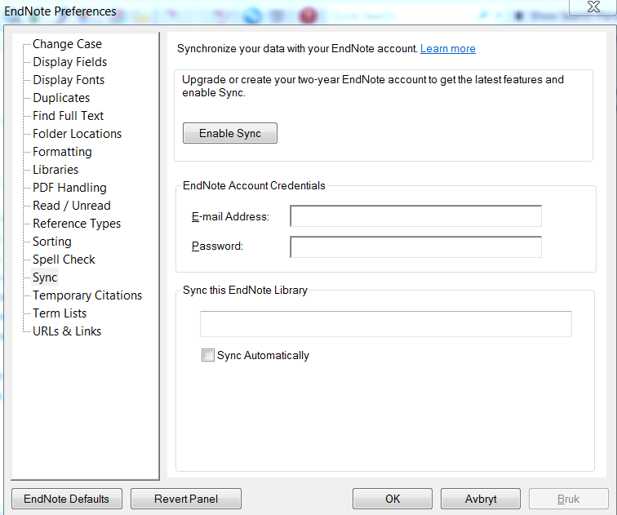
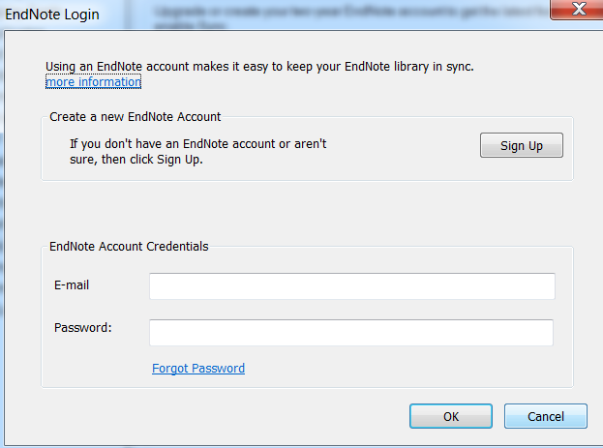
EndNote Library Sharing
Creating a shared library:
Create a new library in EndNote intended for sharing.
Edit → Preferences → Sync (1)
If you have an EndNote Online user, log on (2) and choose "Enable Sync" (3). Finish with "OK".
If you have no EndNote Online user, choose "Enable Sync" (3) and "Sign Up" (4).
3
2
1
4

Slide 4
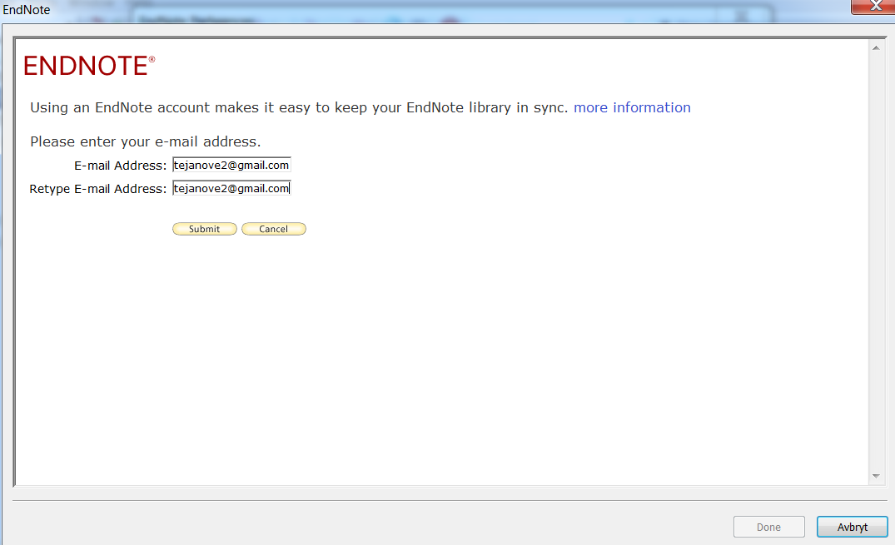
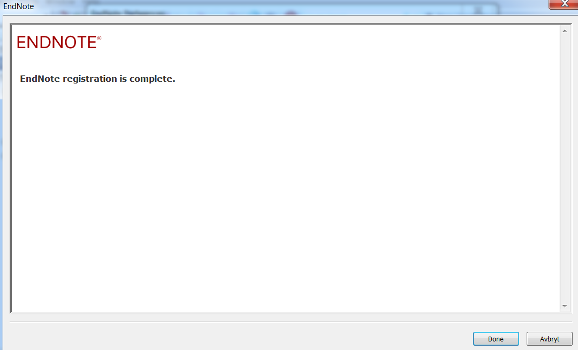
EndNote Library Sharing
Creating a shared library:
Enter email address twice (5) and finish with "Submit" (6).
Complete registration form in next window (not shown here) and finish by accepting the terms.
Finish registration by choosing "Done" (7).
5
6
7

Slide 5
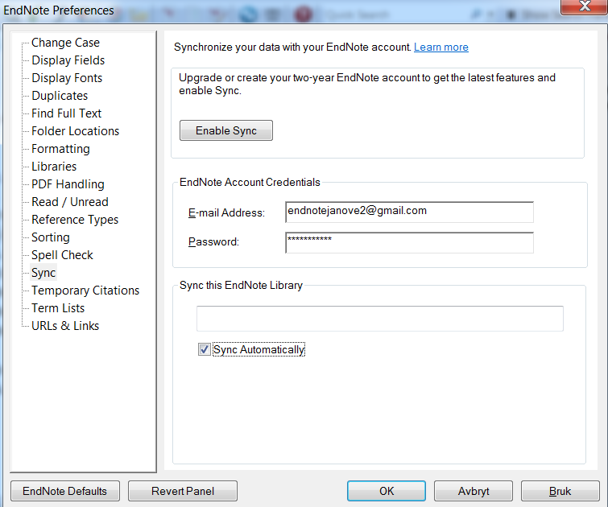
EndNote Library Sharing
Creating a shared library:
Tick "Sync Automatically" (8) finish with "OK" (9).
Your shared library is now ready.
Click "Sync" button (10) to activate first synchronization of the shared library.
The first time you will be asked if you want to make a back up of your library before synchronization. Answer yes if you want to do this.
8
9
10

Slide 6
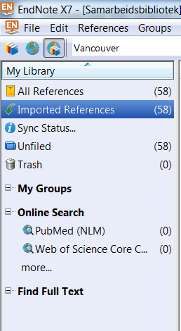
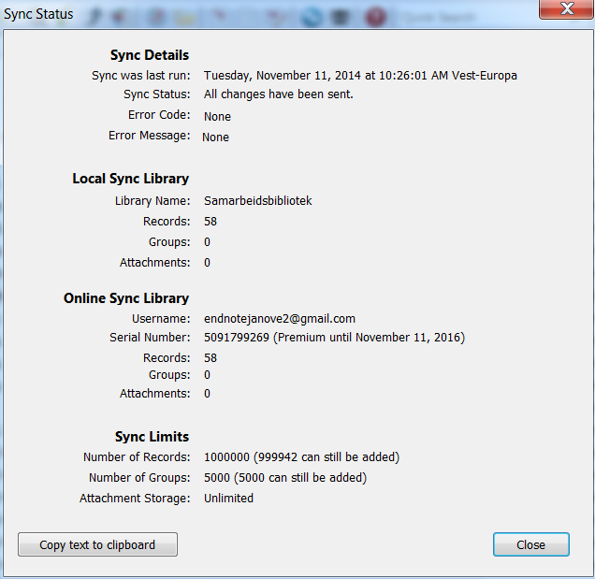
EndNote Library Sharing
Checking status for shared library
14
13
Choose "Sync Status" (13) in left pane to get information about shared library and sync status (14).

Slide 7
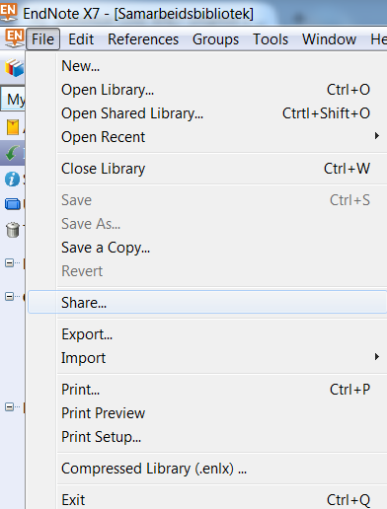
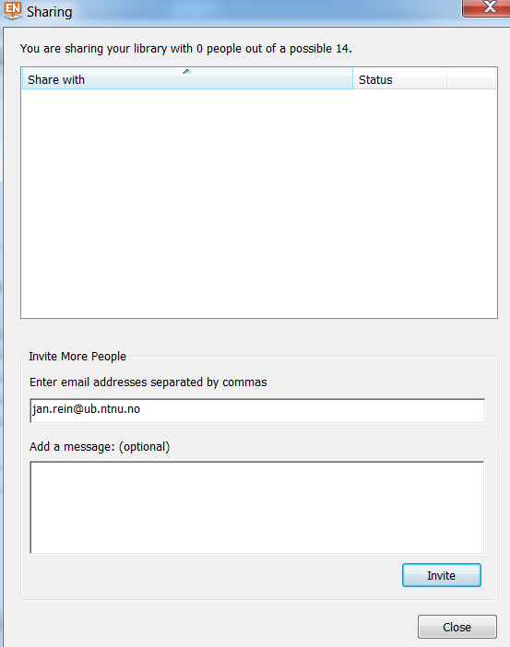
EndNote Library Sharing
Sharing a shared library with other users:
15
16
17
Choose File → Share (15).
Enter the email address for users you want to invite to use the shared library (16). Several emails can be entered at the same time if separated with a comma. Choose "Invite" (17) to send invitations.

Slide 8
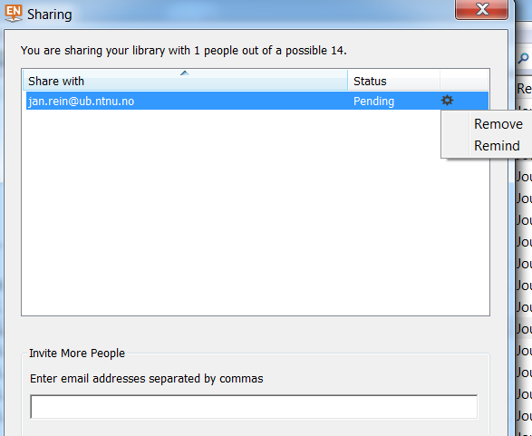
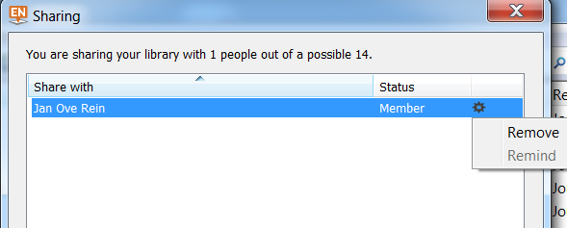
EndNote Library Sharing
Sharing a shared library with other users:
Choose
File → Share to see sharing status (18).
Users who has accepted your invitation have status "Member" (19). You can also remind users that have not responded to your invitation or remove access to the share library.
18
19

Slide 9
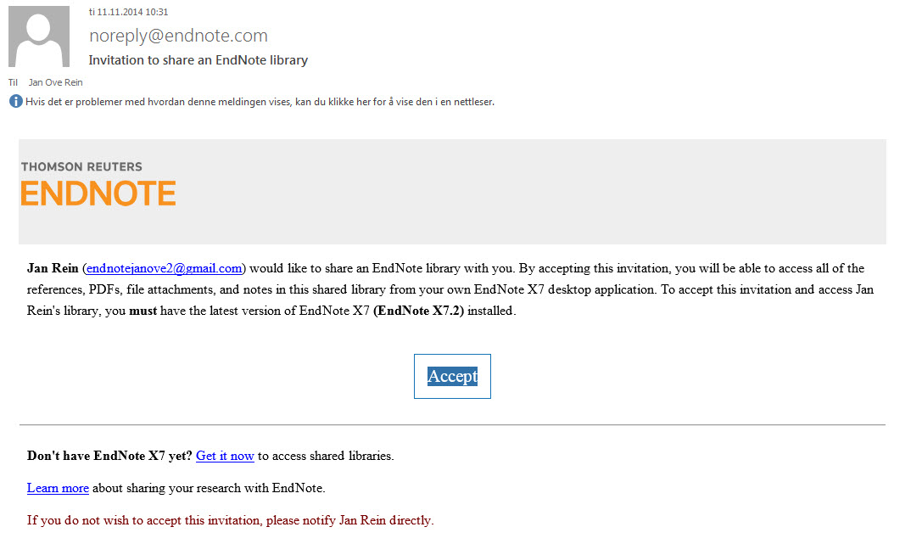
EndNote Library Sharing
Accepting and opening a shared library:
20
21
Invited users will receive an email from EndNote (20). Choose "Accept" (21) and an web page will open (see next slide (22)). Here you can log on with your EndNote Online user og create a new user account first.

Slide 10
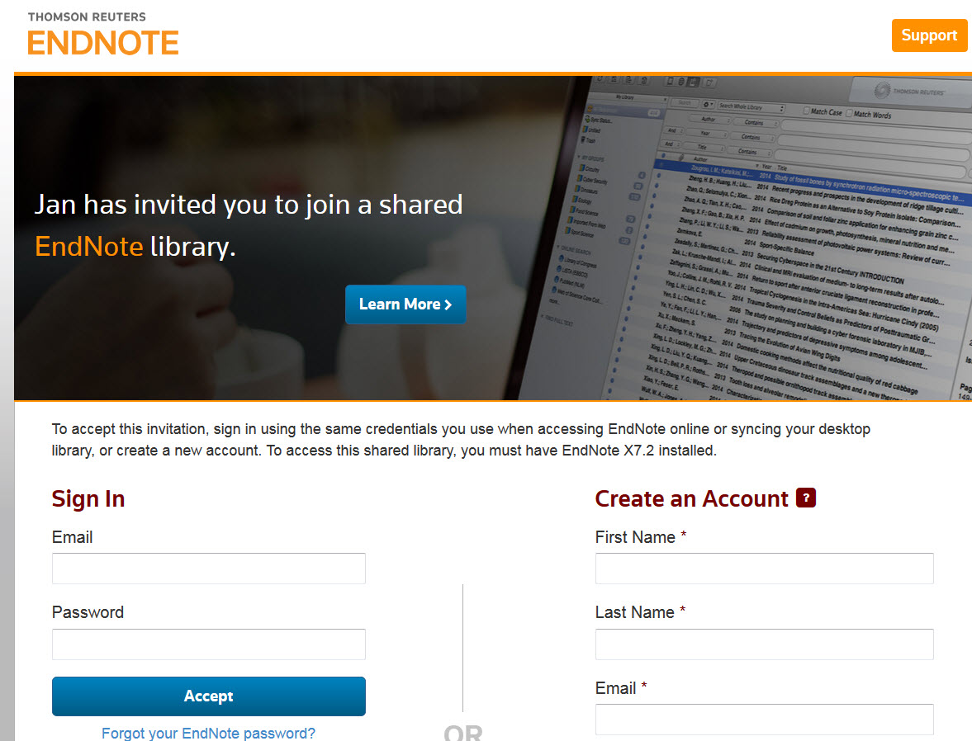
EndNote Library Sharing
Accepting and opening a shared library:
22
After log on, you will get a receipt telling you that you are ready to use the shared library. Go to your EndNote library.

Slide 11
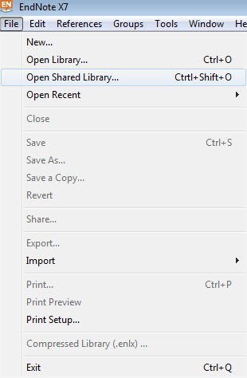
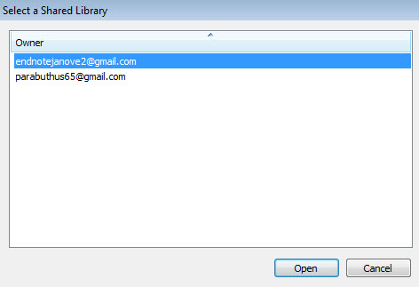
EndNote Library Sharing
Accepting and opening a shared library:
23
24
Close other EndNote libraries in your EndNote.
File → Open Shared Library (23)
Choose shared library by clicking on the mail address to the one inviting you to use the library (the name of the library is not shown).
Choose "Open" (24).
The shared library will open.

Slide 12
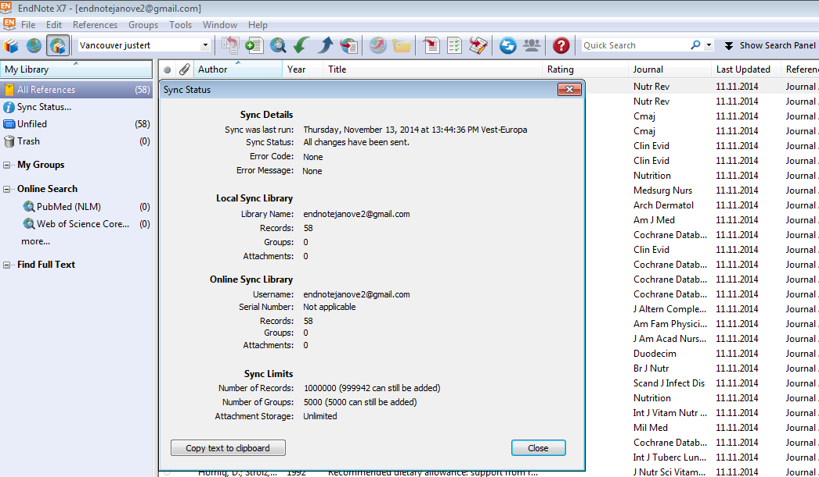
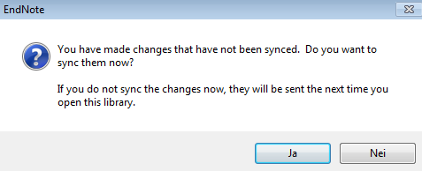
EndNote Library Sharing
Working with a shared library:
25
26
See next slide for more information.

Slide 13
EndNote Library Sharing
Working with a shared library:
When you open a shared library, it will automatically sync with EndNote Online and the library will be updated with changes made by other users.
When you close a shared library, you will be asked if you want to sync it. Choose yes to do this.
You can click on "Sync status" to check the status of a shared library.
Attached pdf files will also be synced in a shared library, as will groups and group sets.
Users using the shared library can work on the same manuscript using this library without getting any reference problems.
Partners can use both EndNote and Word for PC and Mac.
Remember to unformat references in a text/manuscript if you are going to copy and past between documents (Convert citations and bibliography → Convert to unformatted citations).
The library's EndNote support page (in Norwegian):
https://www.ntnu.no/blogger/ub-mh/endnote-referanseverktoy/
Contact the library if you need help!
post@bmh.ntnu.no 72 57 66 80

Slide 14
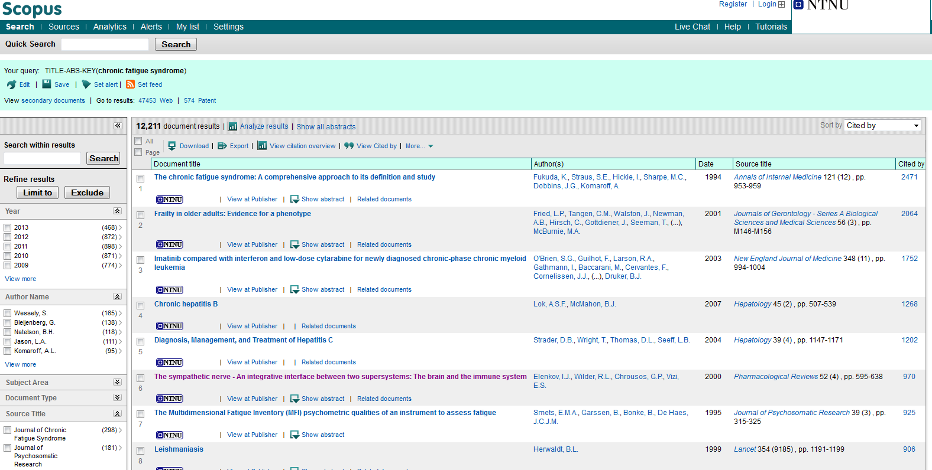
Interdisciplinary
Citations
Scopus - interdisciplinary reference database.
Who sites who – citation tracking
21000 journals, conferences
Link to fulltext or article-ordering =
Measure journal impact (see Analytics)
Check out impact in social media

Slide 15
Søkeeksempel Scopus:
( cacao OR cocoa OR chocolate* ) AND ( hypertension* OR ( blood* W/2 pressure* ) )

