Slide 1
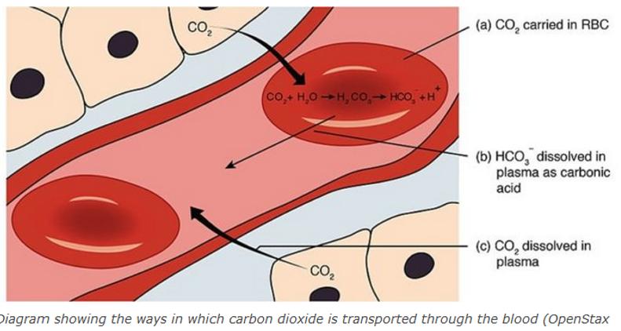
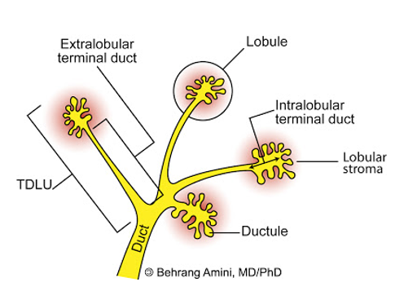
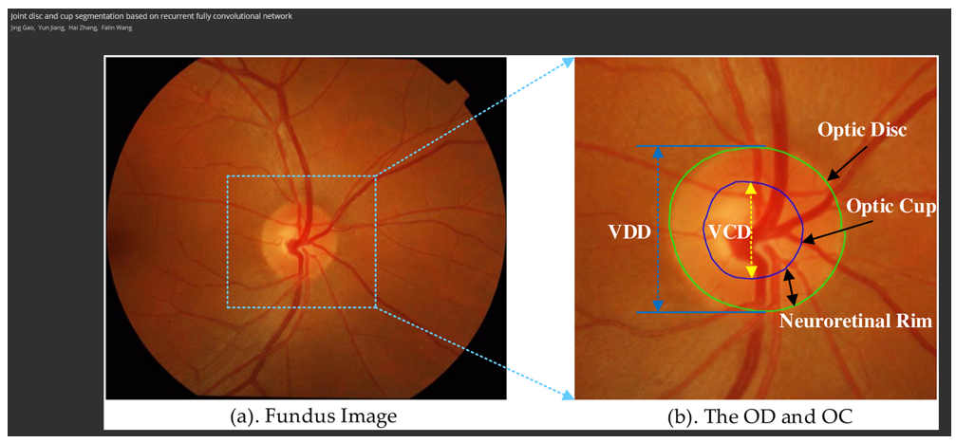
COPYRIGHT AND SCIENTIFIC PUBLISHING SMED8007 – Exercises and links
https://www.menti.com/ Use this code: 8755 3021
Exercise 1: Link: https://en.lifeder.com/most-carbon-dioxide-carried-body-tissues-lungs/ Can you use this figure in your thesis this without permission? Are you allowed to use this figure in a journal article?
Exercise 2: Link: http://roentgenrayreader.blogspot.com/2010/08/terminal-ductal-lobular-unit.html Are you allowed to use this figure in a research article you want to publish or in the body text of your PhD-thesis without asking for permission?
Exercise 3: Link: https://doi.org/10.1371/journal.pone.0238983 Are you allowed to use this figure found in an article in a research article you want to publish or in the body text of your PhD-thesis ("kappa") without asking for permission? Can you edit the figure to add extra content/information?

Slide 2
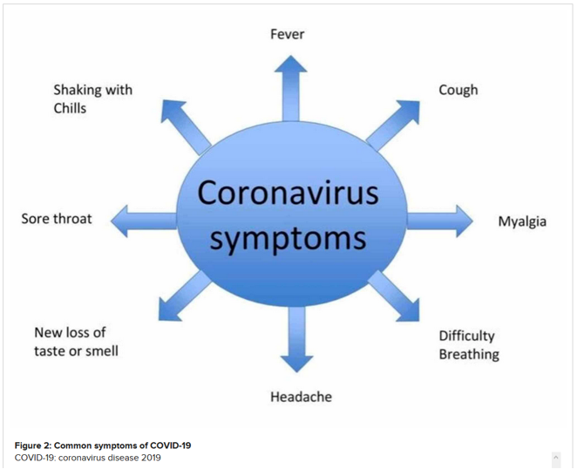
COPYRIGHT AND SCIENTIFIC PUBLISHING SMED8007 – Exercises and links
Exercise 4: Link: https://doi.org/10.7759/cureus.8207 You have found this figure in a recent article in Cureus. Are you allowed to use it in a research article you want to publish or in the body text of your PhD-thesis ("kappa") without asking for permission? Can you edit the figure to add extra content/ information?
Exercise 5: You are preparing your trial lecture on adverse effects of smoking in men for the thesis defense and want to use the picture below as an illustration in the presentation. Is this possible without permission from the copyright holder?

